Slide 1
4.9. UML动态建模表示

Slide 2
4.9 UML动态建模表示
4.9.1 状态图（State-Transition / Statechart Diagram）
4.9.2 活动图（Activity Diagram）
4.9.3 序列图（Sequence Diagram）
4.9.4 协同图（Collaboration Diagram）

Slide 3
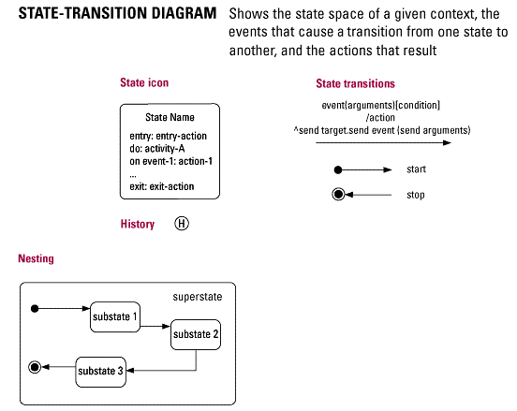
4.9.1 状态图
状态图是表示状态机的图，用来表示模型元素（如对象、交互等）的行为特征。
状态图注重描述可能的状态序列，以及在特定状态下模型元素对外部离散事件的响应动作。

Slide 4
4.9.1 状态图
A statechart diagram shows the flow of control from state to state:
  for a single object.
  shows how the state of the object changes as a result of events that occur.
Elements:
  states
  transitions, guarded transitions
  events
  activities
Composite states: a single state consists of a state machine.

Slide 5
4.9.1 状态图 – state
A state is a condition or situation in the life on an object during which it satisfies some condition, performs some activity, or waits for some event:
  typically described by a set of attribute values.
Examples:
  the state of a credit card account depends on current balance, payment history, …
  the state of an order can be pending（待处理）, filled（已填写）, onBackOrder（因欠款而未执行）, cancelled（取消）, delivered（已交货）, …
  the state of a fax can be Idle, Sending, Receiving.

Slide 6
4.9.1 状态图 – state transition
A state transition occurs as a result of an event:
  state transitions are considered to be atomic (cannot be interrupted).
State transitions may be labeled:
  Event [ Guard ] / Action
An event is the specification of a significant occurrence (a message or signal that is received).
An action is associated with a transition:
  a process that occurs quickly and is not interruptible.
A guard is a logical condition:
  returns true or false.

Slide 7
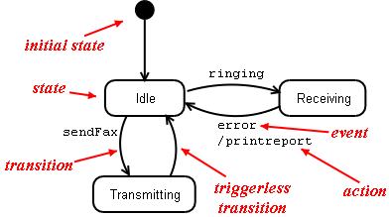
4.9.1 状态图

Slide 8
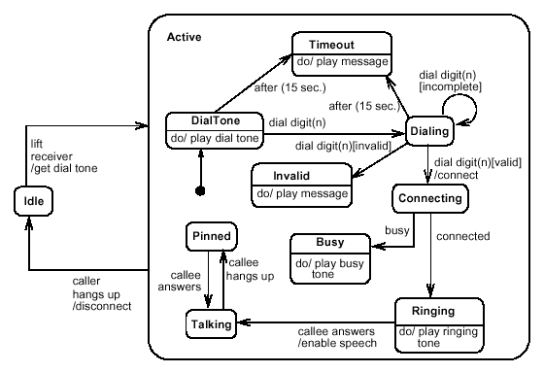
4.9.1 状态图
例：

Slide 9
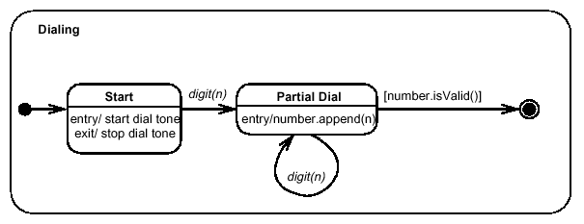
4.9.1 状态图
例：串行状态组合

Slide 10
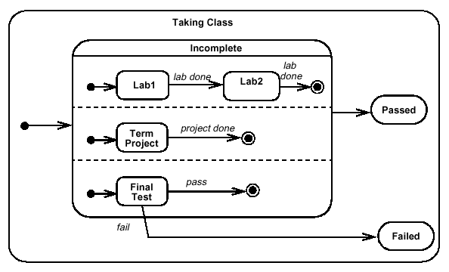
4.9.1 状态图
例：并发状态组合

Slide 11
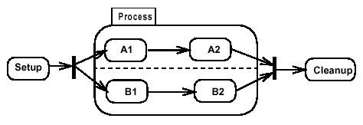
4.9.1 状态图
例：分枝与同步

Slide 12
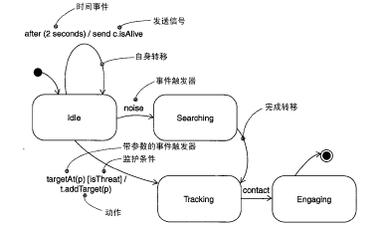
4.9.1 状态图----约束
例：状态图中的约束（V2.0）

Slide 13
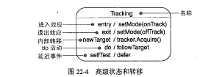
4.9.1 状态图—高级状态和转移
进入效应：进入状态时需执行的动作
退出效应：离开状态时系统执行的动作
内部转移：通过执行一个效应来响应事件，但不离开状态。它不同于状态的自身转移。
do活动：处于某个状态，并一直在做着一个工作至到被某一个事件所中断。
延迟事件：以后再考虑的事件。

Slide 14
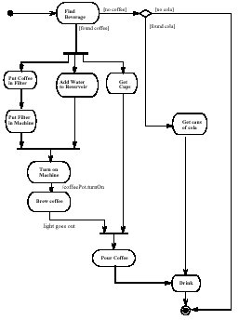
4.9.2 活动图
活动图也是一种状态机，但表示的是特定过程的状态机。
活动图用来表示内部处理的控制流，类似于程序流图。

Slide 15
4.9.2 活动图
UML’s variation on the well-known flowchart.
Describes the sequencing of activities, with support for both sequential and parallel behavior.
Flow of control from activity to activity (workflow):
  start in an initial state.
  transition via action states to a final state.
Use free-format text to describe activities.
Unlike other diagrams, the main emphasis if not on classes and / or objects:
  but it is possible to specify object flow.

Slide 16
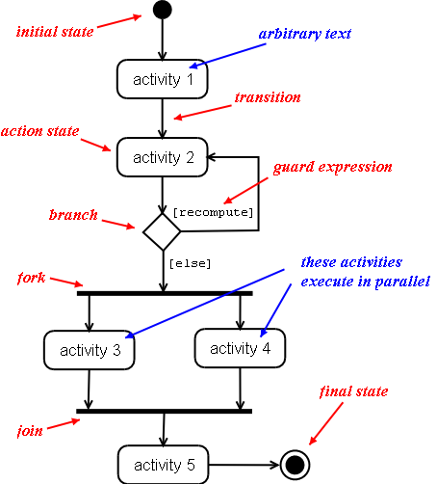
4.9.2 活动图

Slide 17
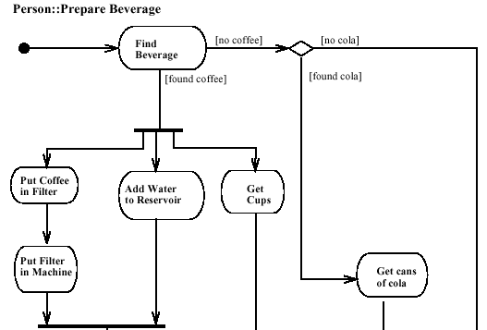
4.9.2 活动图
例：

Slide 18
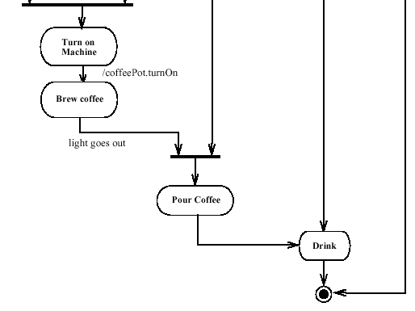
4.9.2 活动图
例：

Slide 19
4.9.2 活动图 – fork and joins
Simple case: all concurrent branches (threads) must have finished before we transition out of the join.
Threads leaving a fork may be traversed in any order (includes interleavings).
Forks and joins may be nested.
Conditional threads out of forks only need to be completed if their condition holds.

Slide 20
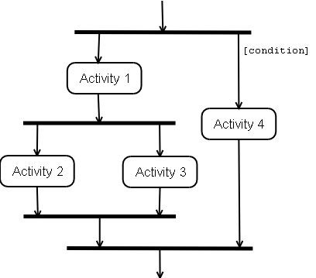
4.9.2 活动图 – fork and joins

Slide 21
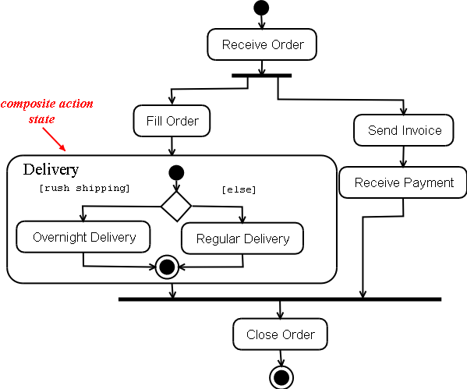
4.9.2 活动图 – composite activities

Slide 22
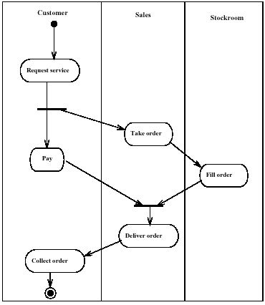
4.9.2 活动图
例：依据类的划分，对活动或子活动的描述进行组织，通常用于描述业务模型。

Slide 23
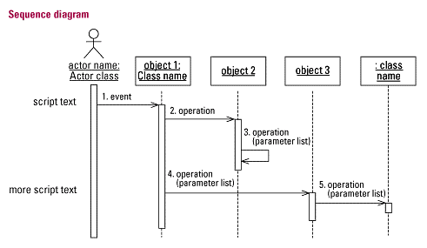
4.9.3 序列图
序列图用于描述以时间为序的交互；
交互是指双方通过消息传递来执行动作和获取结果的过程。

Slide 24
4.9.3 序列图
Shows sequence of operations over time.
Relates behavior of multiple objects.
Elements:
  objects (and their classes).
  lifelines represent an object’s existence in time.
  message exchanges between objects.
Arrangement:
  objects organized horizontally.
  time flows downward to model an object’s “lifeline”.
  arrows between lifelines represent method calls
    bidirectional to model call/return.

Slide 25
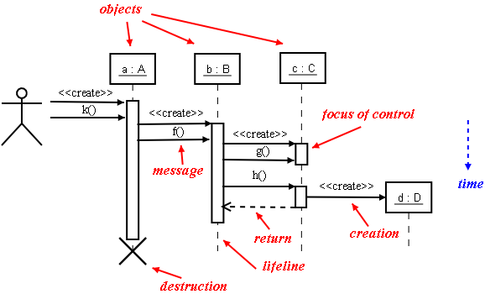
4.9.3 序列图

Slide 26
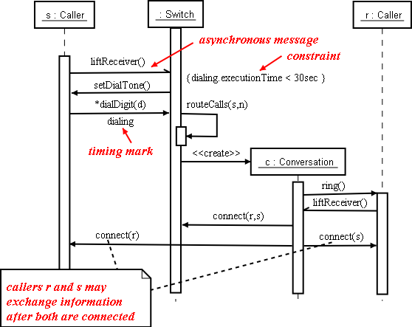
4.9.3 序列图
例：

Slide 27
4.9.3 序列图
Synchronous messages:
  correspond to procedure calls.
  caller is “blocked” until control returns.
  notation: full arrow.
There are also asynchronous messages:
  correspond to “signals”.
  notation: half-headed arrow.
  can create new thread, new object, communicate with existing thread.

Slide 28
4.9.3 序列图
Typically, a sequence diagram models only one flow of control:
  use conditions for simple conditional logic.
  otherwise, use multiple sequence diagrams .
Returns are typically omitted.
Use focus of control to visualize when computation is taking place.
You can show actors in sequence diagrams of this helps understanding the diagram.
Keep it simple!

Slide 29
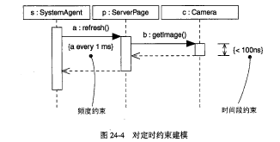
4.9.4 定时图
是一种交互图，它展现了消息跨越不同对象或角色的实际时间，而不仅仅是关心消息的相对顺序。

Slide 30
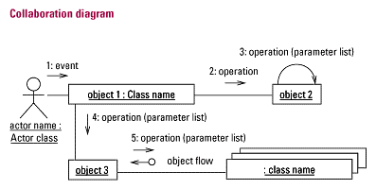
4.9.5 协同图 (V2.0改为通信图)
协同图用于描述系统中
不同角色之间的交互。
这里的交互描述强调角色之间的联系，而不是时间顺序。

Slide 31
4.9.5 协同图
Very similar to sequence diagrams, but emphasizes structural organization instead of time.
Elements:
  objects.
  links between objects.
  multiple messages may be sent along each link:
    <<create>> message models object creation.
  associate sequence numbers with messages:
    1, 2, 3, 4, …
    1, 1.1, 1.2, 2, 2.1, 2.1.1, 2.2, 2.3 (makes relationships between methods explicit).

Slide 32
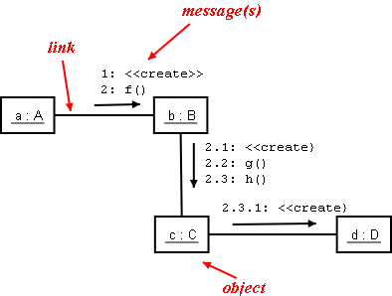
4.9.5 协同图

Slide 33
4.9.5 协同图
Collaboration diagrams may also contain:
  conditions
  iteration (*)
  self-calls
  asynchronous messages
Conversion between collaboration diagrams and sequence diagrams always possible:
  each kind of diagrams has unique advantages.

Slide 34
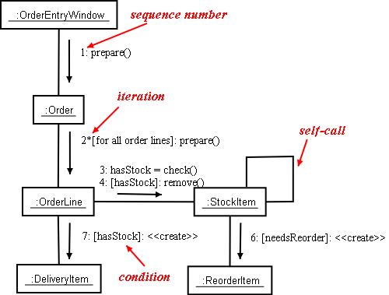
4.9.5 协同图
例：

Slide 35
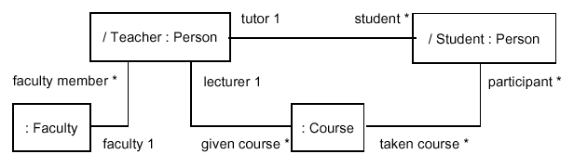
4.9.5 协同图
例：处于规格说明层次的协同图，重点描述角色类别之间的关系

Slide 36
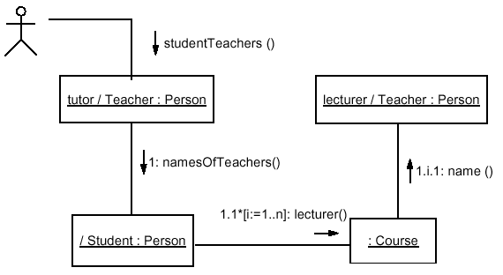
4.9.5 协同图
例：处于实例层次的协同图，重点描述对象的角色之间的关系。

Slide 37
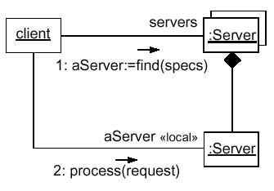
4.9.5 协同图
例：涉及多个对象的协同图。
协同图中箭头的涵义与序列图相同。
:= 表示返回值的赋值。

Slide 38
4.10. UML系统实现表示

Slide 39
4.10 UML系统实现表示
4.10.1 制品图（Artifact Diagram）
4.10.2 组件图（Component Diagram）
4.10.3 部署图（Deployment Diagram）
4.10.4 系统和子系统（System and Subsystem）

Slide 40
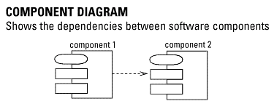
4.10.1 组件图
组件图用于描述系统中不同的软件组件之间的依赖关系，这些组件包括源码组件、二进制码组件、可执行组件。

Slide 41
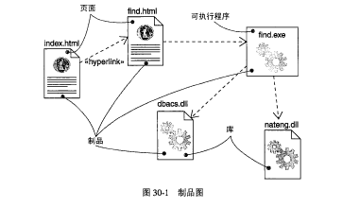
4.10.1 制品图
制品图展示了一组制品及它们之间的关系。在图形上，制品图是顶点和弧的集合。

Slide 42
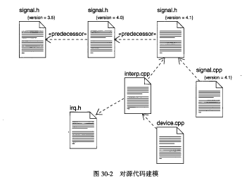
4.10.1 制品图
制品图展示了一组制品及它们之间的关系。在图形上，制品图是顶点和弧的集合。

Slide 43
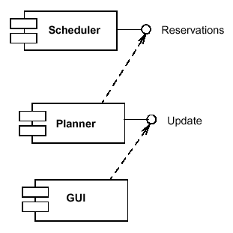
4.10.2 组件图
例：表示组件与另一组件的接口之间的依赖关系。

Slide 44
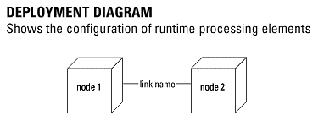
4.10.3 部署图
部署图用于描述系统在运行时组件、进程以及其中的对象的配置关系。

Slide 45

4.10.3 部署图
Client Workstation
Application Server -
Compaq PIII 500
例：
HP Kayak XU-400
TCP/IP
Client Source Code
SAP R/3
Comment
Comment
(client.exe)
TCP/IP
Database Server -
Compaq PIII 500
Oracle 8
Comment

Slide 46
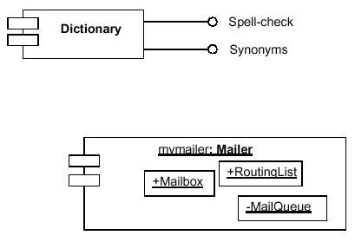
4.10.3 部署图
例：部署图中接口和运行时对象的表示。

Slide 47
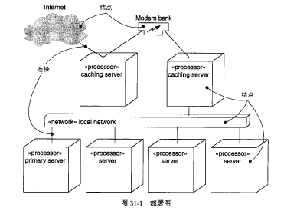
4.10.3 部署图
例：用部署图可视化物理结点的静态方面以及它们之间的关系，并详述其构造的细节。

Slide 48
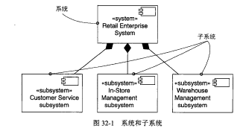
4.10.4 系统和子系统
系统（System）：是一组为完成一定的目标而组织起来的元素，这些元素是用一组模型分别从不同的角度描述的。一个系统可以被分解为一组子系统。
子系统（Subsystem）:是元素的组合，其中一些元素构成了对由另一些被包含元素所提供的行为的规约。

Slide 49
4.11. 代码生成与文档生成

Slide 50
4.11 代码生成与文档生成
4.11.1 从模型生成代码
4.11.2 在Rose中设定代码生成的特性
4.11.3 文档自动生成的原理

Slide 51
4.11.1 从模型生成代码
以Rose为例，目前能够生成代码的只有类图。
代码生成与目标语言的设定有关。
用类图可以自动生成类的定义（全部）和类的实现（仅限于方法的框架），后者的内容需程序员自己加入。
所生成的代码中，有自动更新和保留两部分，前者在每次生成时都随模型变化而变化，后者（是程序员自己加入的内容）则在生成时保持不变。

Slide 52









4.11.1 从模型生成代码
例：用类 SharedHeap 的模型产生对应的 .h 文件和 .cpp 文件。
SharedHeap
(from SharedData)
cpHeap : char[HEAP_SIZE]
lHasAlloced : long = 0
cpStartPtr : char * = NULL
shmMalloc(iSize : int = 0) : void *
resetHeap() : void

Slide 53
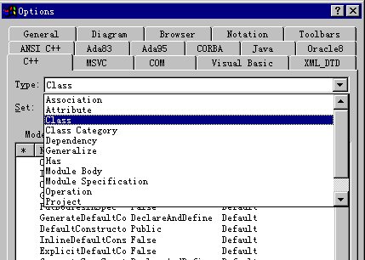
4.11.2 在Rose中设定代码生成的特性
在Rose . Tools . Model Properties . Edit下，可设定代码生成的特性。

Slide 54
4.11.3 文档自动生成的原理
以Rose为例，所有用UML建立的模型都以文本方式存储在对应的.mdl文件中。
文档自动生成工具（SoDa）分析.mdl文件，根据欲生成的文档的模板中的要求，过滤出所需的信息，填入该文档模板的一个实例（Word文件）中，最后产生以该模板为框架的一份文档。
由于是根据模型自动生成，所以可始终保持一致。

Slide 55
4.11.3 文档自动生成的原理
SoDa自带的文档模板有几十种（均为英文），可以用Word手工将其改为中文模板。
文档模板的格式可以自己定义，但要采用SoDa规定的描述语言。

Slide 56
4.12. 面向对象系统分析

Slide 57
4.12.1 面向对象分析与设计的基本概念
Object-oriented analysis
  Investigation that is object-centric.
Object-oriented design
  Solution in terms of interacting software objects
Object-oriented programming
  Coding in an object-oriented programming language.
Analysis
Design
Implementation
Investigation of
the problem
Logical solution
Code

Slide 58
4.12.1 面向对象分析与设计的基本概念
Requirements Analysis: discover and express requirements in use cases. Use Case is a textual description of a business process in the system.
Domain Analysis: develop a conceptual model of the problem domain. This includes the things, the concepts, as well as the various roles people may take and the relationships between them.
Design - Assignment of Responsibilities: allocate tasks to software objects as well as roles people take, illustrated in interaction diagrams and logical class diagrams.

Slide 59
4.12.1 面向对象分析与设计的基本概念
Model-driven（模型驱动的） Analysis Approaches:
  Structured Analysis
  Information Engineering
  Object-oriented Analysis
Accelerated（加速的） Analysis Approaches:
  Discovery Prototyping
  Rapid Architecture Analysis

Slide 60
4.12.1 面向对象分析与设计的基本概念
Model-driven analysis emphasizes the drawing of pictorial system models to document and validate both existing and/or proposed systems. Ultimately, the system model becomes the blueprint for designing and constructing an improved system.
A model is a representation of either reality or vision. Just as “a picture is worth a thousand words,” most models use pictures to represent the reality or vision.

Slide 61
4.12.1 面向对象分析与设计的基本概念
A functional requirement（功能性需求） is a description of activities and services a system must provide.
A nonfunctional requirement（非功能性需求） is a description of other features, characteristics, and constraints that define a satisfactory system.

Slide 62
4.12.2 功能性需求的建模
采用 UML 进行系统分析的第一步，是以 Use case 图为主要工具，对信息系统的功能性需求进行寻找、描述和整理。
功能性需求建模的结果以 Use Case Model 的形式表示。
Use case 可以用来作为系统计划的基础。可以对 Use case 相关的时间和资源要求进行估计。如果这样的估计无法从某个 Use case得出，则可以对所有相关的剧情进行估计，以得出整体上的时间和资源要求。
Use case 可以用来作为分析、设计和实现的基础。在对 Use case 中描述的消息交互序列与执行动作进行分析后，设计和实现相应的系统元素，以满足 Use case 规定的交互。

Slide 63
4.12.2 功能性需求的建模
Use case 可以作为测试的基础。在 Use case 中描述的消息交互序列与执行动作，可以用来作为测试用例来确认系统功能是否达到了预期的要求。
Use case 可以作为文档（例如用户操作手册等）的基础，因为 Use case 表达了用户使用系统的方式。

Slide 64
4.12.3 范例：一个图书馆信息系统的需求建模
A library lends books and videos (called resources).
Different categories of books and videos have different periods of loan.
System functions (business functions):
Ref #
R 1.1
R 1.2
R 1.3
R 1.4
R 1.5
...
Function
Record the loan of the resources.
Calculate the due date of loaned resources.
Generate borrowing reports.
Record new resources for loan.
Generate overdue loans reports.
...

Slide 65
4.12.3 范例：一个图书馆信息系统的需求建模
Use cases:
  Describe the sequence of events of an actor using a system to complete a process.
  Represent business or domain processes.
  Are a narrative（叙述性的） description of a business process.
  Are expressed in structured prose（散文）.
  Are not directly related to object technology.
Borrow Resources

Slide 66
4.12.3 范例：一个图书馆信息系统的需求建模
A high-level use case:
  High level use cases briefly describe major processes in the organization.
Name: Borrow Resources
Actors: Patron (initiator（该用例的启动者）), Librarian
Description: The use case begins when the Patron arrives
at the check-out with books and videos to borrow and
submit them to the Librarian, who records the
resources borrowed. The Patron then leaves with the
resources.

Slide 67
4.12.3 范例：一个图书馆信息系统的需求建模
Actors:
  An actor in a use case is an external agent that uses or interacts with the system.
  There is one initiator actor and possibly several participating actors in a use case.
Patron
Librarian

Slide 68
4.12.3 范例：一个图书馆信息系统的需求建模
Actors can be:
  Roles of humans.
    Example: A Patron.
  Other computer systems.
    Example: The Visa network.
  Inanimate physical objects, such as electro-mechanical devices.
    Example: A robot.

Slide 69
4.12.3 范例：一个图书馆信息系统的需求建模
Use case diagrams:
Borrow Resources
Librarian
Add Resources
Patron
Return Resources

Slide 70
4.12.3 范例：一个图书馆信息系统的需求建模
Choosing the system boundary:
  A use case describes events upon a system.
    This implies a system boundary is chosen.
  Typically boundaries.
    Hardware / software boundary of a device or computer system.
    Department of an organization.
    Entire organization.

Slide 71
4.12.3 范例：一个图书馆信息系统的需求建模
Choosing the system boundary:
Library Information
System
Computer
system is
boundary
Library
Library is
boundary
Borrow Resources
Borrow Resources
Librarian
Add Resources
Patron
Patron
Return Resources
Return Resources

Slide 72
4.12.3 范例：一个图书馆信息系统的需求建模
Identifying use cases:
  1. Define the system boundary.
  2. Identify actors.
    External entities participating in domain processes.
    Examples: customers, clerks, managers, technicians, external computer systems.
  3. For each actor, determine:
    What fundamentally different processes / actions does it participate in?
    What initial event does an actor perform to start a process?
  Each fundamentally different process of each actor is a use case.

Slide 73
4.12.3 范例：一个图书馆信息系统的需求建模
Sample high-level primary use cases:
Name: Borrow Resources
Actors: Patron (initiator), Librarian
Description: The use case begins when the Patron arrives
at the check-out with books and videos to borrow and
submit them to the Librarian, who records the
resources borrowed. The Patron then leaves with the
resources.

Slide 74
4.12.3 范例：一个图书馆信息系统的需求建模
Sample high-level primary use cases:
Name: Add Resources
Actors: Librarian
Description: The use case begins when the Librarian receives
new resources (books and videos) to add to the catalog.
The title, call number, and other information are
recorded. Then the resources are placed on a shelf
organized by resource type and call numbers.

Slide 75
4.12.3 范例：一个图书馆信息系统的需求建模
Other possible use cases:
  Return a Resource.
  Delete a Resource.
  Notify Overdue Patrons.
  Collect Fines.

Slide 76
4.12.3 范例：一个图书馆信息系统的需求建模
A common error in identifying use cases is to represent individual steps, operations, or transactions as use cases.
  A use case is a relatively large end-to-end process that typically includes many steps or transactions; it is not normally an individual step or activity in a process.
  It is possible to break down portions of a use case into subordinate use cases (called abstract use cases), but this is nor the norm.

Slide 77
4.12.3 范例：一个图书馆信息系统的需求建模
In practice, use cases are categorized in many dimensions:
CATEGORY
NAME
Detail level
Task level
Importance
Abstraction
High level / Expanded
Super / Sub (Abstract)
Primary / Secondary
Essential / Real

Slide 78
4.12.3 范例：一个图书馆信息系统的需求建模
In practice, use cases are categorized in many dimensions:
CATEGORY
NAME
Detail level
Task level
Importance
Abstraction
High level / Expanded
Super / Sub (Abstract)
Primary / Secondary
Essential / Real
HIGH-LEVEL EXPANDED
General, brief Detailed, showing exact
description of processes order of events and
alternatives

Slide 79
4.12.3 范例：一个图书馆信息系统的需求建模
SUPERPROCESS SUBPROCESS (ABSTRACT)
A broad task use case A subtask of a superprocess use case.
that is subdivided into Also known as an abstract use case
subprocesses. （是实际中并非单独存在的用例）
In practice, use cases are categorized in many dimensions:
CATEGORY
NAME
Detail level
Task level
Importance
Abstraction
High level / Expanded
Super / Sub (Abstract)
Primary / Secondary
Essential / Real
  The special includes relationship can relate some use cases (not all).
  If A includes B, we can say A is a superprocess and B is a subprocess.

Slide 80
4.12.3 范例：一个图书馆信息系统的需求建模
In practice, use cases are categorized in many dimensions:
CATEGORY
NAME
Detail level
Task level
Importance
Abstraction
High level / Expanded
Super / Sub (Abstract)
Primary / Secondary
Essential / Real
PRIMARY SECONDARY
Describes a major, Describes a rare, unusual,
common process or exceptional process.

Slide 81
4.12.3 范例：一个图书馆信息系统的需求建模
ESSENTIAL REAL
The essence of the Concrete, design-oriented.
process. Analysis-oriented.
Expresses process Expressed in terms of the
(relatively) independent of solution – screen shots of
a hardware / software windows, entry into input
solution. Fields, and so forth.
In practice, use cases are categorized in many dimensions:
CATEGORY
NAME
Detail level
Task level
Importance
Abstraction
High level / Expanded
Super / Sub (Abstract)
Primary / Secondary
Essential / Real

Slide 82
4.12.3 范例：一个图书馆信息系统的需求建模
Example:
Essential Real
The Librarian records the The Librarian uses the laser
Call number. wand to scan the bar code for
the call number, which is
transmitted to the computer.
The AccountHolder The AccountHolder inserts
identifies himself to the the card into the ATM card
ATM. reader. He is prompted to
enter his PIN (see screen
shot 4), which he inputs with
a numeric keypad.

Slide 83
4.12.3 范例：一个图书馆信息系统的需求建模
Expanded format use cases:
  Describe the use case in greater detail.
  Can be written essential or real.
  Have the following components:
    Name
      Starts with a verb.
    Description
      From the high-level use case.
    Actors
      Initiator and participants from the high-level use case.
    Type
      If decomposed, then super / sub (abstract).
      Also, primary / secondary, and essential / real.

Slide 84
4.12.3 范例：一个图书馆信息系统的需求建模
Expanded format use cases:
  Have the following components (continued):
    Cross-references
      Related use cases and system functions.
    Preconditions
      Assumptions that must hold true.
    Typical course of events
      Most important section describes regular flow of events.
    Alternatives
      Exceptional alternatives that might arise.

Slide 85
4.12.3 范例：一个图书馆信息系统的需求建模
Expanded use cases – Example:
  Name: Borrow Resources.
  Description: (As in high-level use case)
  Actors: Patron (initiator), Librarian
  Type: Primary, essential
  Cross-references: System functions R1.1, R1.2, R1.3
  Preconditions: Patron has a library card.

Slide 86
4.12.3 范例：一个图书馆信息系统的需求建模
Typical course of events:
Actor Action
1. This use case begins when the Patron submits resources (books and videos) for borrowing.
2. The Librarian takes the Patron’s library card and resources.
3. The Librarian checks the card status by recording Patron’s Library ID.
5. The Librarian records the call number of each resources.
System Response
4. Indicates valid membership.
6. The due date is calculated and the loan is recorded.

Slide 87
4.12.3 范例：一个图书馆信息系统的需求建模
Typical course of events (continued):
Actor Action
7. On completion of entry, the Librarian requests a borrowing report.
9. The Librarian Transfers the report to the Patron.
10. The Patron leaves with the resources and report.
System Response
8. A borrowing report is generated.
Alternatives:
  Alternative at 4: If the Patron card is invalid, do not allow borrowing.
  Alternative at 5: If the Resource missing a call number, set it aside for repair and do not allow borrowing.

Slide 88
4.12.3 范例：一个图书馆信息系统的需求建模
What to describe in a use case:
  Emphasize events between actors and the system without decomposing the internal processing of the system.
  Orient toward things that the actors can perceive（感知）.
  Discussion of internal processing or design decision is permissible, but should be done with knowledge of the consequences.
    Example: Early design commitments（承诺）.

Slide 89
4.12.3 范例：一个图书馆信息系统的需求建模
Use case miscellany（杂记）:
  The first line of a use case course of events should describe the event that starts the use case.
    Example: This use case begins when the <actor> <generates an input event>.
  Start the use case name with a verb
    Purchase …
    Borrow ...

Slide 90
4.12.3 范例：一个图书馆信息系统的需求建模
Relating use cases:
  Use cases can be organized and related to simplify their descriptions.
  Three associations are:
    Includes.
    Extends.
    Generalization-specialization.

Slide 91
4.12.3 范例：一个图书馆信息系统的需求建模
Includes:
  Includes: “The insertion of additional behavior into a base use case that explicitly describes the insertion.”
    Used to factor out a shared subprocess.
Borrow Resources
Renew Membership
<<include>>
<<include>>
Check Privileges

Slide 92
4.12.3 范例：一个图书馆信息系统的需求建模
Includes (continued):
  When a super-task use case (base use case) uses a subtask use case (an abstract use case).
    An abstract use case is a factored-out subtask that does not stand on its own as a complete, separate process.
  In the use case text, the base use case explicitly initiates the abstract use case.
    “initiates” is a verb favored by some use case writers.
Use Case: Borrow Resources
…
Step 5. Initiate use case Check Library Privileges
...

Slide 93
4.12.3 范例：一个图书馆信息系统的需求建模
Includes (continued):
  When to use?
    When several use cases share a common subflow that can be factored out.
    When a use case is too complex and needs factoring into smaller, understandable chunks.

Slide 94
4.12.3 范例：一个图书馆信息系统的需求建模
Extends:
  extends: “The insertion of additional behavior into a base use case that does not know about it.”
  Used to extend an existing self-complete story.
Borrow Resources
Renew Membership
<<extend>>
<<extend>>
<<extend>>
Return Resources
Join Library As Patron

Slide 95
4.12.3 范例：一个图书馆信息系统的需求建模
Extends (continued):
  When a second use case extends the story of the first use case.
    “Chapter 1 followed by Chapter 2.”
  The two use cases are complete on their own.
  The first use case does not know about or refer to the second use case.

Slide 96
4.12.3 范例：一个图书馆信息系统的需求建模
Extends (continued):
  The second use case can extend the first at its end or at any point - the extension point.
  The second use case might unconditionally extend the first or only under some condition.
  In the use case text of the second, it notes (in the Cross Reference section) that it extends the first.
Use Case: Return Resources
…
Cross-References: Extends use case Borrow Resources
...

Slide 97
4.12.3 范例：一个图书馆信息系统的需求建模
Extends (continued):
  When to use?
    To add new possible postflows to complete use case.
    To show a conditional or alternate subflow.

Slide 98
4.12.3 范例：一个图书馆信息系统的需求建模
Generalization-Specialization:
  “… to add a more specific use case that inherits and adds features to (a more general use case).”
<<include>>
Pay Fine
Arrange Payment
Pay by Cash
Arrange Credit

Slide 99
4.12.3 范例：一个图书馆信息系统的需求建模
Generalization-Specialization (continued):
  Example:
Use Case: Pay Fine
…
Step 3. Initiate use case Arrange Payment.
...
Use Case: Arrange Payment
…
Step 1. Collect payment
Step 2. Verify payment
Step 3. Record payment
...

Slide 100
4.12.3 范例：一个图书馆信息系统的需求建模
Generalization-Specialization (continued):
  Example (continued):
Use Case: Pay by Cash
…
Cross References: Specializes Arrange Payment.
...
Use Case: Arrange Credit
…
Cross References: Specializes Arrange Payment.
...

Slide 101
要点与引伸
动态模型描述的是目标系统与对象状态（数据值）相关 / 与并发与同步相关 / 与时间相关 / 与处理逻辑相关的、多侧面的动态特征，重点体现了系统中主要对象之间的协同关系，这对于表现和理解并发、分布系统是至关重要的。
信息系统必须实现用户所需的业务功能。
利用 Use case 进行功能性需求建模，首先要完整地表达出用户需求，其次还要帮助用户对需求进行归纳、抽象和整理，后者体现在对 Use case 的适度分解与相互关联定义上。
利用 Use case 进行功能性需求建模，是从本质功能到功能细节渐进的发现和认识过程，重要的是抓住系统功能的本质。
识别 Actor 和 Use cases、阅读和书写高层次的和详细格式的 Use cases、区分本质的 Use cases 和 现实的 Use cases，这些技能是利用 Use case 进行功能性需求建模的关键。

